Slide 1





EXPLORATORY
DATA ANALYSIS
FOR
OVERSEAS FILIPINO WORKERS

Slide 2







ABRACA DATA
KEN MANALAD
PIOLO BAYETA
MARK KEVIN BELINO
AIRA MAE ONDA
APRIL JOY AGQUIZ

Slide 3

OVERSEAS
FILIPINO
WORKERS

Slide 4



Kristine
Region IV-A CALABARZON

Slide 5
Problem Statement
Low Domestic Wages and Wage Differentials.
The value of the Philippine peso is shrinking.

Slide 6
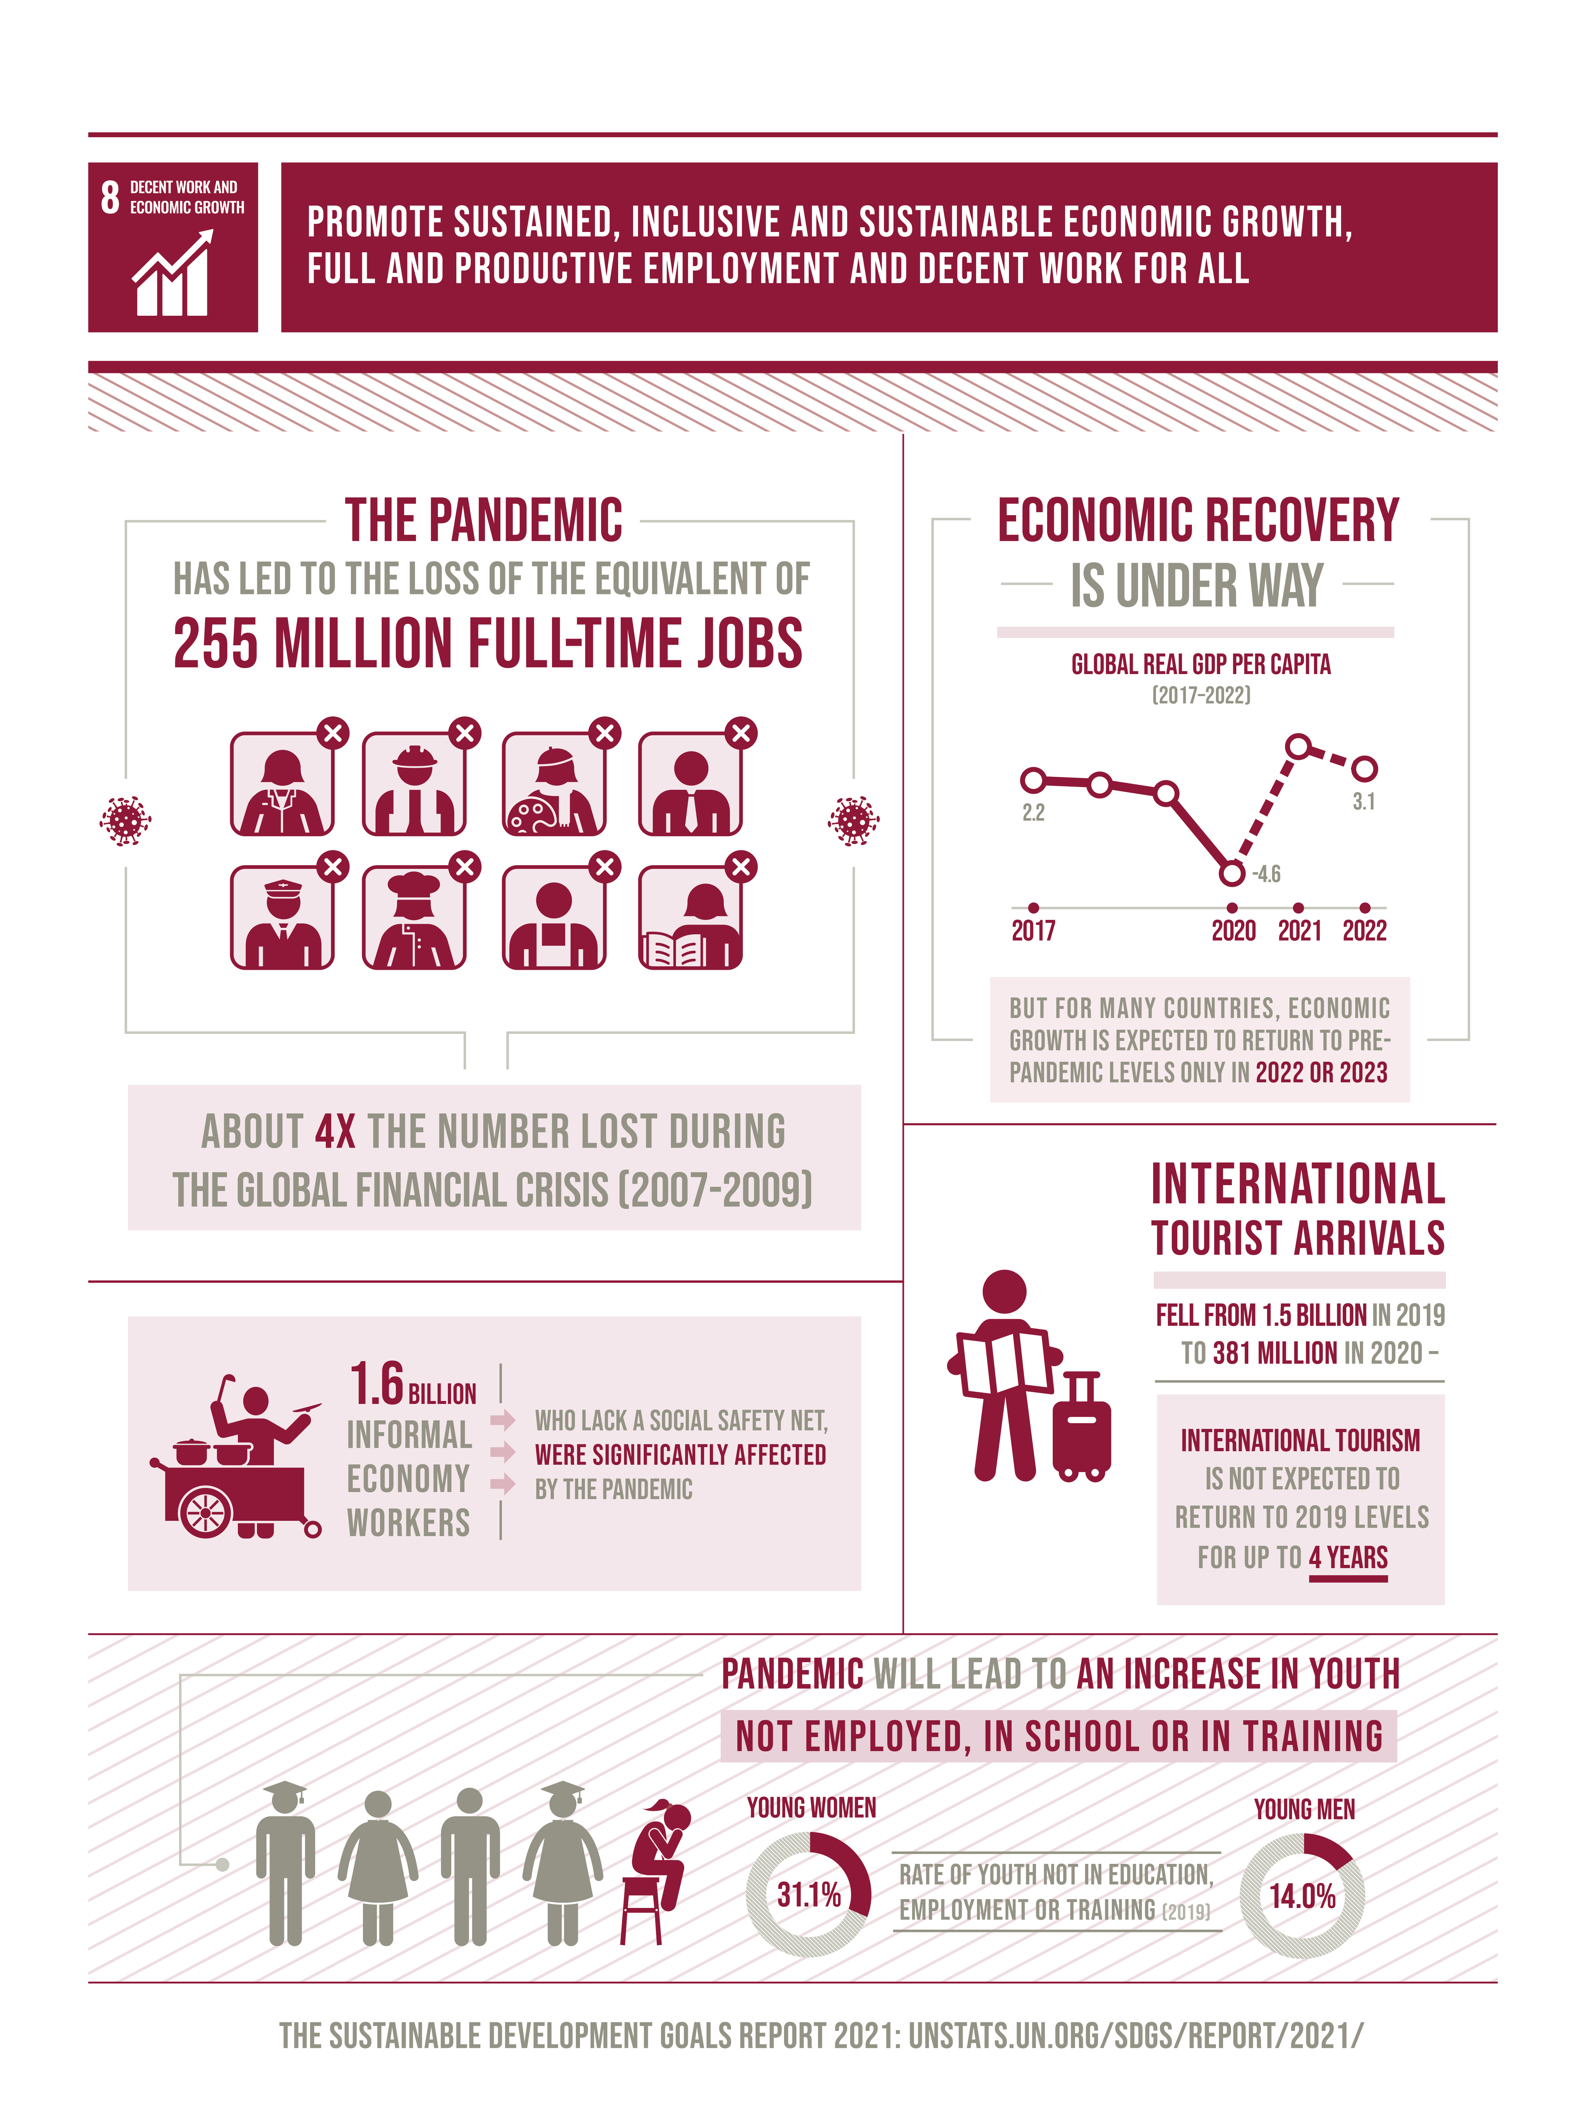
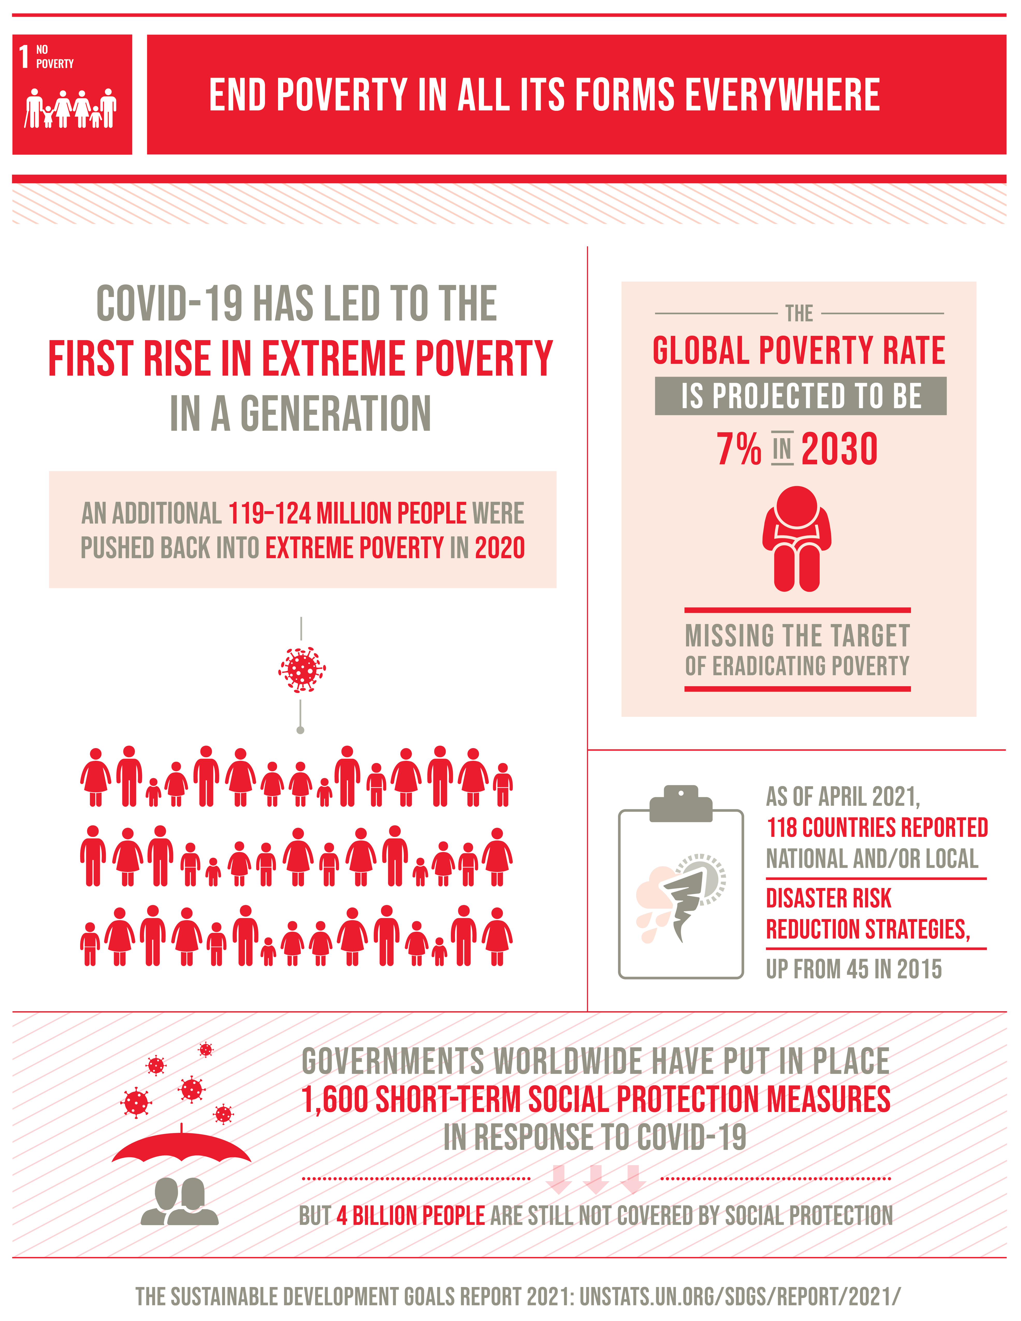
SUSTAINABLE
DEVELOPMENT
GOALS

Slide 7
FINDINGS
FOR
OVERSEAS FILIPINO WORKERS

Slide 8
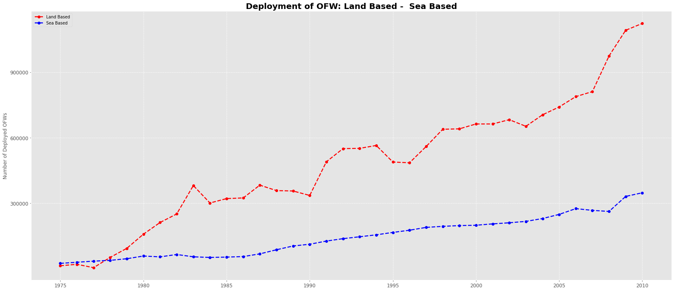

Year

Slide 9
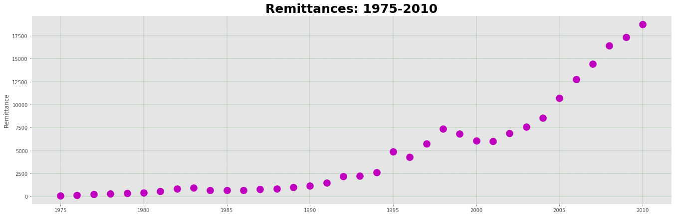
Year

Slide 10
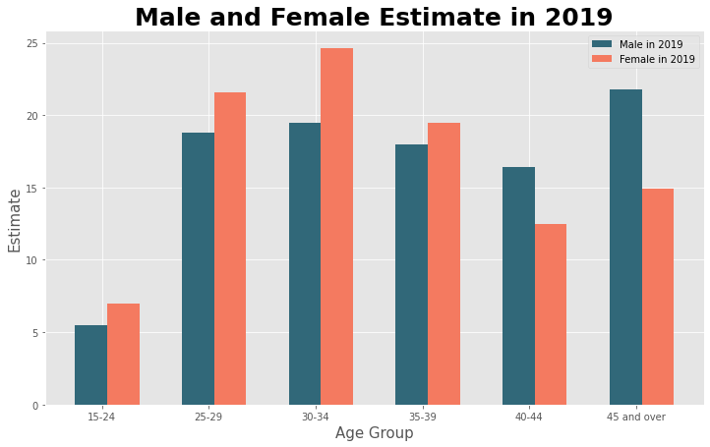
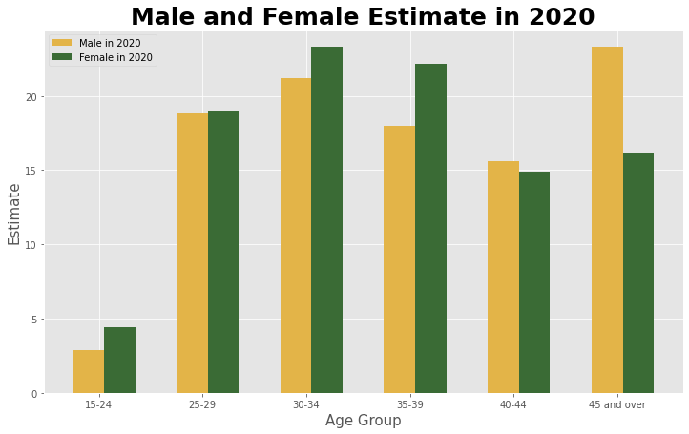
Percent Distribution
by Age Group
The chart shows that female overseas workers outnumbered males aged 30-34 in 2019 and 2020. Male and female aged 15 to 24 are the least estimated in 2019 and 2020.

Slide 11
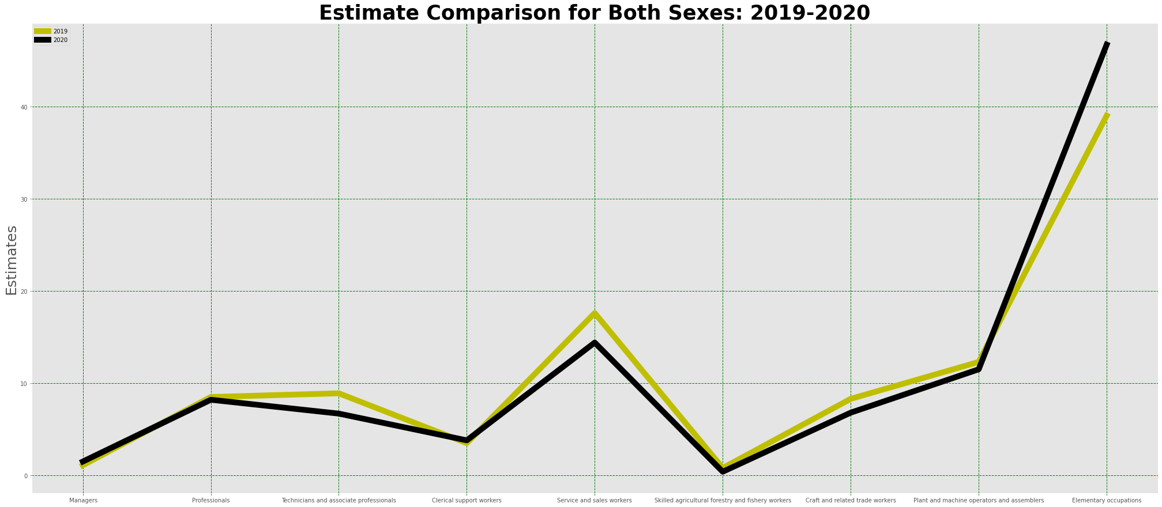
Major Occupation
Most OFW are employed in the elementary occupation
Major Occupation

Slide 12
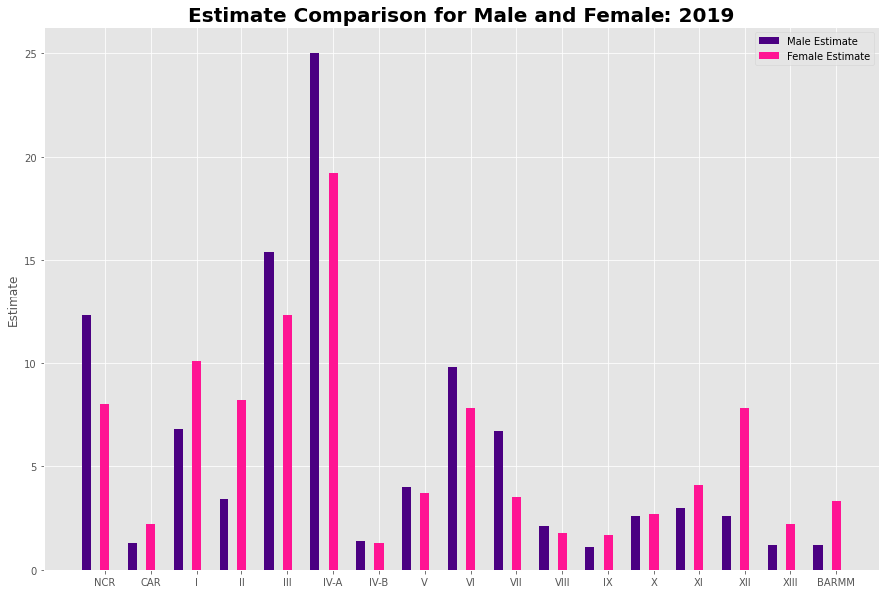

Region

Slide 13
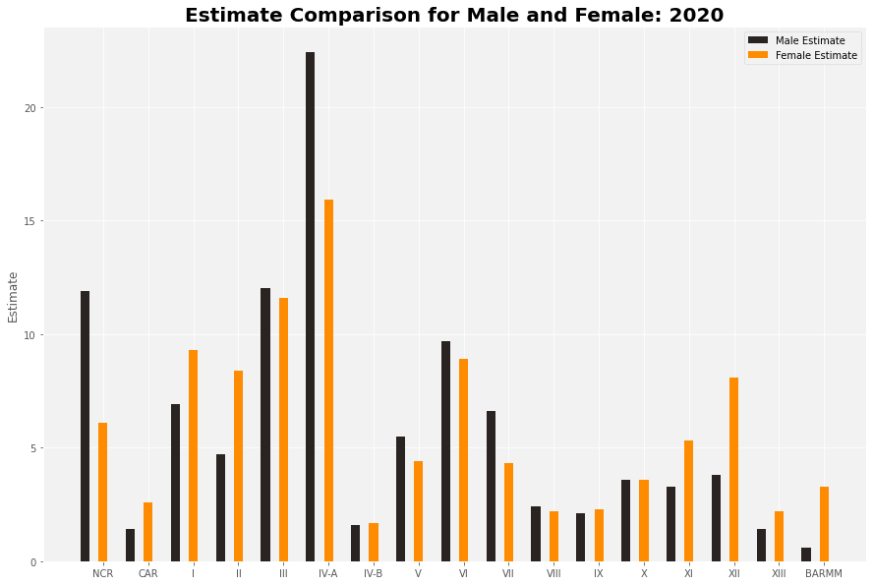
Region

Slide 14
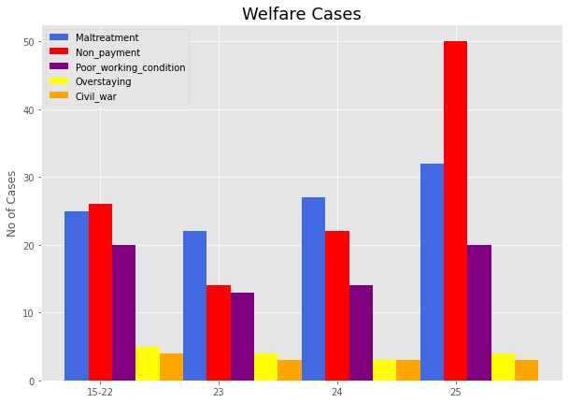
A total of 50 Overseas Filipino workers are the most victims of nonpayment wages.
Age Group

Slide 15

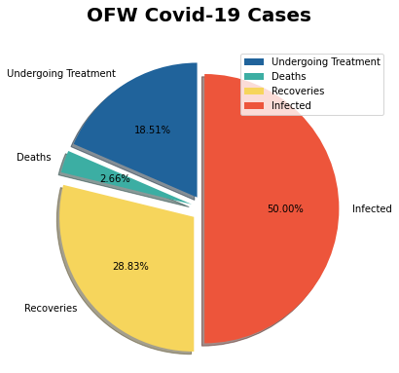

The highest percentage allocation of 50.00 percent indicates the number of Infected OFWs. Deaths, on the other hand, are cases with a minimum allocation percentage of 2.66 percent.

Slide 16
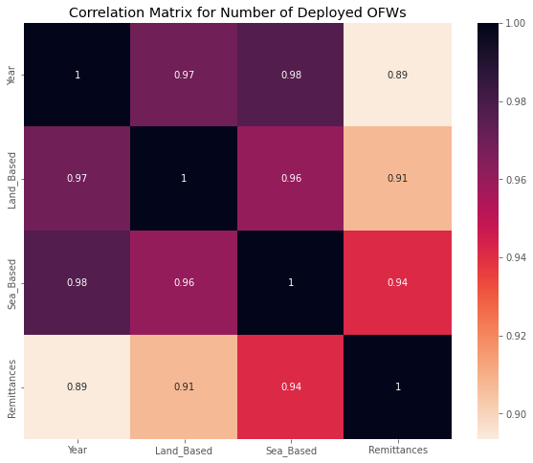

Slide 17
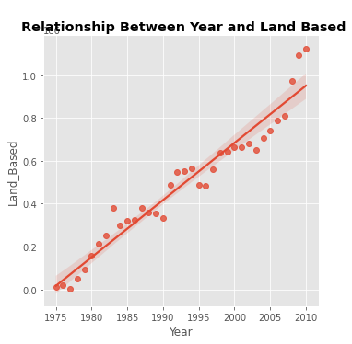
Positive Correlation Between
Year and
Land-Based: 0.97

Slide 18
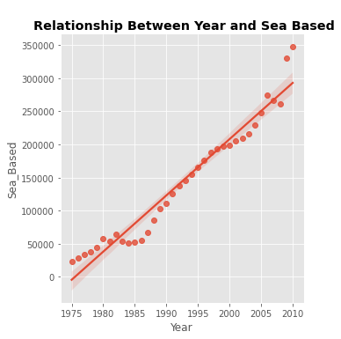
Positive Correlation Between
Year and
Sea-Based: 0.98

Slide 19
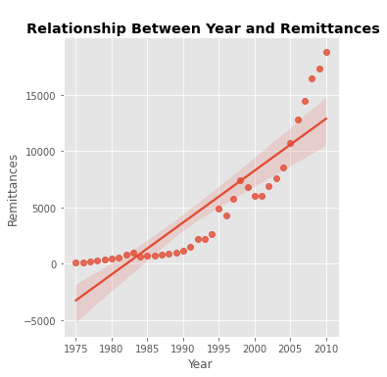
Positive Correlation Between
Year and
Remittances: 0.89

Slide 20
RECOMMENDATION
FOR
OVERSEAS FILIPINO WORKERS

Slide 21


Impose regulations to ensure a higher level of protection and empower migrants and their communities.
Protection
Enhance government resources and opportunities for OFWs and their families.
Enhancement
ACTION PLAN
Monetary
Facilitate OFWs in obtaining financial sustainability, which benefits our country's economy.
Training
Indulge in knowledge and expertise development for our overseas workers.

Slide 22
THANK
YOU

Slide 23
REFERENCES
Modern Day Heroes: 5 Reasons Why OFWs Get Such Title. (2014, April 30). Pinoy-OFW.com
https://www.pinoy-ofw.com/news/32634-modern-day heroes.html?fbclid=IwAR0S9PlSbTlbAtHsvgBIaNTKISGjLFOsn3e4rC7JJ0lldWoYpfDJJuzvZdY
OFW: ANG BAGONG BAYANI | DOLE-CAR. (n.d.). Car.dole.gov.ph. Retrieved April 11, 2022
https://car.dole.gov.ph/news/ofw-ang-bagongbayani/?fbclid=IwAR1PIh0yuDEo0zyIWOq3B1jz7kKI35eRvoLo7ahXDsDiwZubSa8VwRW86_8
Overseas Filipino Workers Free Essay Example. (2016, July 23). StudyMoose
https://studymoose.com/overseas-filipino-workers essay?fbclid=IwAR1PIh0yuDEo0zyIWOq3B1jz7kKI35eRvoLo7ahXDsDiwZubSa8VwRW86_8
Overseas Filipino Remittances · innovate.dti.gov.ph. (n.d.). Innovate.dti.gov.ph. Retrieved April 11, 2022
https://innovate.dti.gov.ph/about/btipr-services/statistics/overseas-filipinoremittances/?fbclid=IwAR3X5InTG1iw5wXw2Iq_39UPeH47bNg9wY1KgPg7FHtiIXMWsHe2RQ0QycA

Slide 24
Sayres, N. (n.d.). AN ANALYSIS OF THE SITUATION OF FILIPINO DOMESTIC WORKERS ILO Special Action Programme to Combat Forced Labour: Mobilizing Action for the Protection of Domestic Workers from Forced Labour and Trafficking in Southeast Asia. Retrieved April 11, 2022
https://www.ilo.org/wcmsp5/groups/public/---asia/---ro-bangkok/---ilomanila/documents/publication/wcms_124895.pdf?fbclid=IwAR2sAnmG9KrGjTCoOJvOIUElPFV2HRFuFdsw q78swxKlopiltmjRnltJJVk
Marie, S., & Cosalan, B. (2010). STUDY ON THE OVERSEAS FILIPINO WORKER: A GENERAL PROFILE
https://core.ac.uk/download/pdf/213853084.pdf
Philippine Statistics Authority. (2020, June 4). Total Number of OFWs Estimated at 2.2 Million | Philippine Statistics Authority. Psa.gov.ph.
. Psa.gov.ph. https://psa.gov.ph/content/total-number-ofws-estimated-22-million

Slide 25
The Filipino Youth and the Employment-Migration Nexus
January 2013
https://www.researchgate.net/publication/261547728_The_Filipino_Youth_and_the_Employment-Migration_Nexus/figures?lo=1
Effect of COVID-19 Pandemic on OFW Deployment and Remittances. April 11, 2022
http://legacy.senate.gov.ph/publications/SEPO/AAG_Migration%20and%20Remittances%20%20amidst%20COVID%2019_final.pdf?fbclid=IwAR0-G2psVbdKEUKRnfcpKkHyQ8WrdN-4_GtuaT0hZlAK7dBajU2w8IHnIWc
THE 17 GOALS | Sustainable Development Goals
https://sdgs.un.org/goals?fbclid=IwAR0QnFCOeYxNmgFuD8PfiyMunxqSQy4N4c7rYY_TtNym7936j60U5aSxqAo

Slide 26
DATASETS
Overseas Filipino Remittances · innovate.dti.gov.ph. (n.d.). Innovate.dti.gov.ph. Retrieved April 11, 2022
https://innovate.dti.gov.ph/about/btipr-services/statistics/overseas-filipinoremittances/?fbclid=IwAR3X5InTG1iw5wXw2Iq_39UPeH47bNg9wY1KgPg7FHtiIXMWsHe2RQ0QycA

